Slide 1
Suicide Prevention Strategy, 2011: LGBTs
Jan Bridget
www.galyic.org.uk

Slide 2
All Areas are Relevant to LGBTs
High Risk Groups:
young and middle aged men
people with a history of self-harm
Tailor approaches to improve mental health in specific groups, including:
Survivors of abuse and violence
Children and young people
People who misuse drugs or alcohol
LGBTs (first time such a high profile)

Slide 3
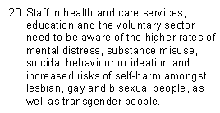
Awareness of LGBT vulnerabilities

Slide 4
LGBTs
Reference to previous research (reveals male bias i.e. emphasises gay and bisexual men)
More recent research shows lesbians, bisexual women and transgender people just as vulnerable

Slide 5
Youth Chances, Interim, 2012 (2,840, 16-25s): Self Harm
Over half of LGBQ respondents (53%) have hurt themselves on purpose (self-harmed).
67% of female LGBQ respondents have hurt themselves on purpose, compared to 36% of male LGBQ respondents
Three-quarters (75%) of transgender respondents have hurt themselves on purpose, with a staggering 27% still actively self-harming.
The reported rate of self-harm amongst LGBTQ young people is higher than national statistics show; with respondents to the Youth Chances survey reporting rates of self-harm that are nearly 4 times higher in women and 5 times higher in men.

Slide 6
LGF: 4,000 LGBs 2012: substance misuse
1/5th scored as dependent on a substance, and 1/4 showed at least one indicator of dependency;
34% of gay and bisexual men and 29% of lesbian and bisexual women binge-drink at least once or twice a week, around twice as common than in the wider population;
35% of those surveyed had taken at least one illicit substance in the last month, which is around seven times more common than in the general population;

Slide 7
PACE: Where to Turn?
http://www.galyic.org.uk/docs/pace_report.pdf
Includes several references to Gay and Lesbian Youth in Calderdale including the use of the Needs Assessment Tool as “impressive and comprehensive.”
Also reference to the Organisation Cultural Competence Self Assessment Tool GALYIC helped to develop with National CAMHS Support Service:
http://www.galyic.org.uk/support/professionals.html

Slide 8
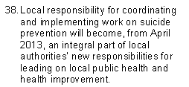
Making it Happen

Slide 9
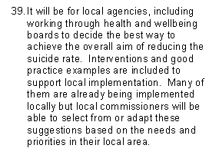
Health & Wellbeing Boards

Slide 10
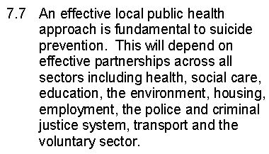
Effective Partnerships

Slide 11
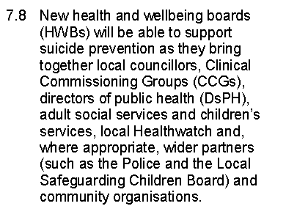
Health and Wellbeing Boards

Slide 12
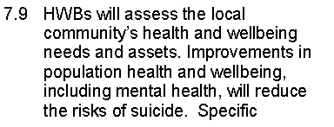
Assessing local needs

Slide 13
www.galyic.org.uk
Support/health/health inequalities
Support/health/mental health
Support/health/substance misuse
Support/coming out
Support/bullying
Support/housing
Support/parents
Support/professionals
Training/training packages:
on-line training programme
supporting LGBT young people in education
News

Slide 14
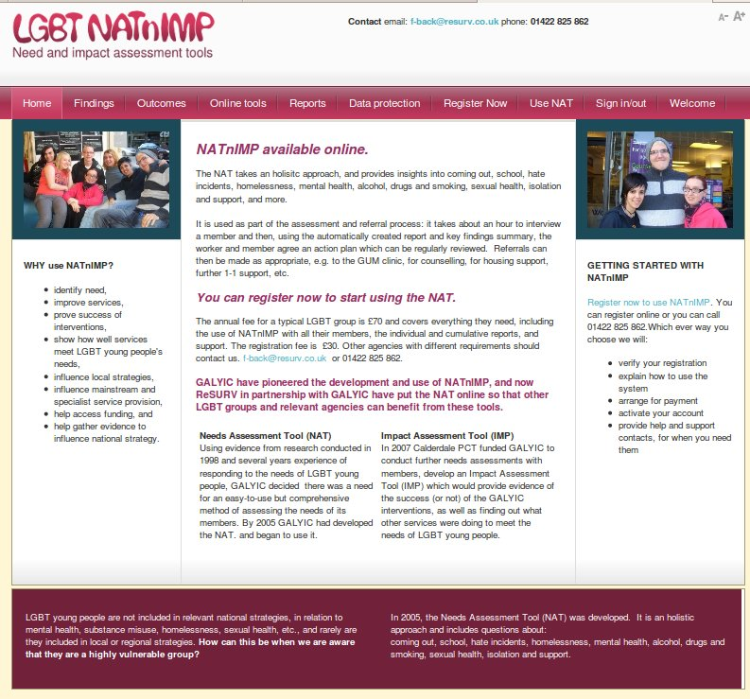

Slide 15
How move forward?
How ensure health and care, education and voluntary sector staff aware higher rates of mental distress, substance misuse, suicide ideation and self harm amongst LGBTs?
How access PACE’s Where to Turn?
How ensure Health and Wellbeing Board includes LGBT issues?
How include LGBTs in local assessments?
How develop tailored services for LGBTs?
What targetted local support is there for LGBTs, in particular for youth, older LGBTs, mental health, substance misuse?

